Slide 1
Freight Train Management System
Da214 course project
By Onkar Shinde
220150021

Slide 2

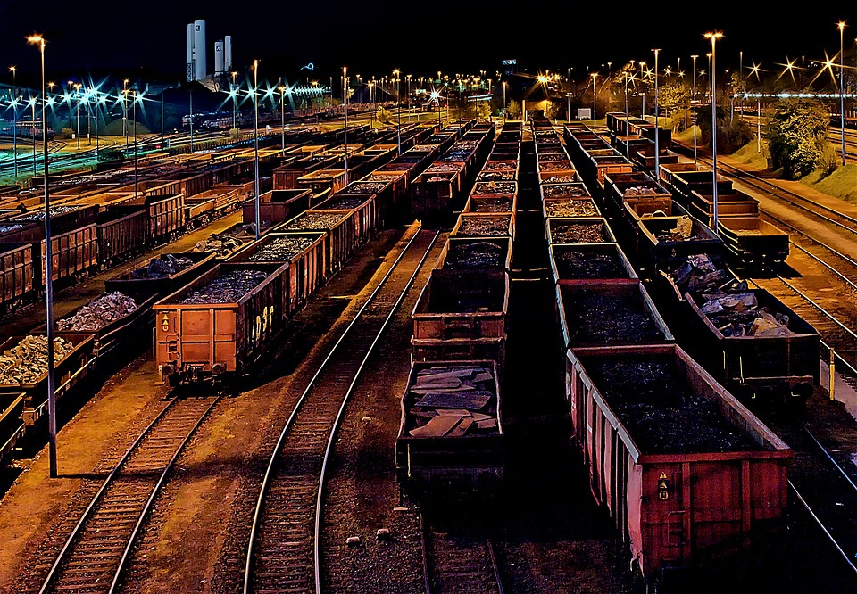
Overview of project
This project focuses on the development of a Freight Train Management System.
The system is aimed at enhancing the efficiency and logistics of cargo transportation via trains.
Key objectives include streamlining the process of booking cargo, cancelling cargo and booking history and tracking shipments by train schedules for Users
Admin have basic features like scheduling trains, new trains adding and tracking shipments in real-time and much more. We will see in next slides.
The system will optimize train schedules based on cargo availability to ensure efficient utilization of resources.
Additionally, the system will offer transparent booking and tracking processes to enhance customer satisfaction.
Overall, the goal is to develop a robust and user-friendly platform that meets the needs of both administrators and customers in the freight train management industry.

Slide 3

Problem statements
The current process of managing cargo transportation via trains faces several challenges, leading to inefficiencies and operational hurdles within the freight industry. These challenges include:​
Manual Booking Processes: The reliance on manual booking processes for cargo shipments results in delays, errors, and inefficiencies in scheduling and resource utilization.
Lack of Real-Time Visibility: Limited real-time visibility into train schedules and cargo status makes it difficult for stakeholders to make timely decisions and respond effectively to delays.
Data Management Challenges: Managing and analyzing vast amounts of operational and financial data manually poses significant challenges, hindering the ability to derive actionable insights for improving performance and decision-making.

Slide 4

Motivation
Efficiency: Our project aims to optimize the freight logistics process, reducing delays and minimizing resource wastage.
Transparency: By providing stakeholders with real-time visibility into train schedules, cargo status, and pricing models.
Customer Satisfaction: With a focus on user-friendly interfaces and responsive customer support, our system seeks to enhance the overall experience for cargo shippers and receivers, ensuring smooth transactions and timely deliveries.
Innovation: Embracing cutting-edge technologies such as machine learning and real-time data processing, our project endeavors to push the boundaries of traditional freight management, paving the way for a more efficient and sustainable future in logistics(to be done in future).

Slide 5
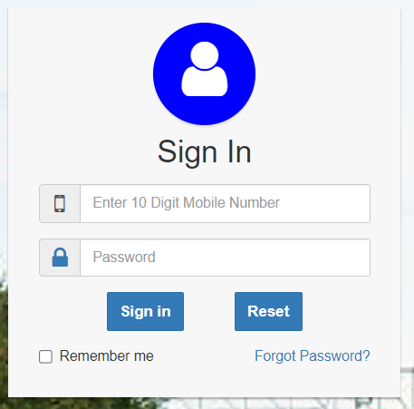

Features of the System
For User​​
Sign In page
Here In bottom right corner, there is forgot password option which sends email to registered email their username and password

Slide 6
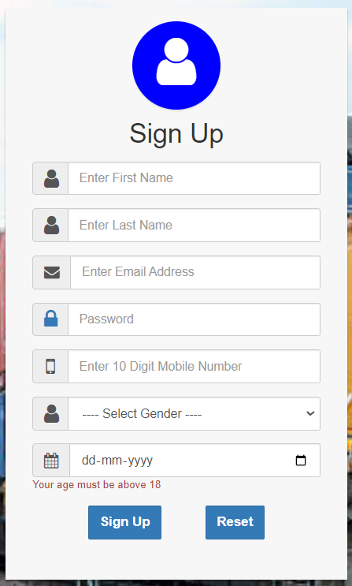
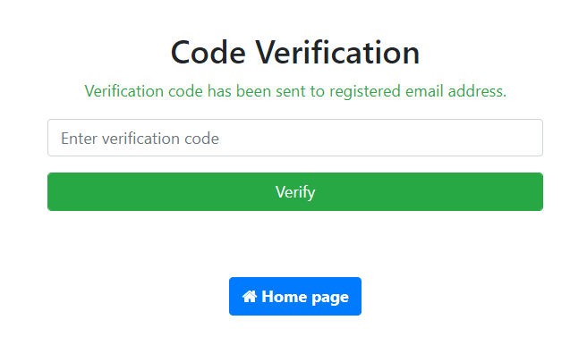
Features of the System ​​
Signing Up
While signing up of user he must enter verification code send to his Email id registered for security of user and further it will be helpful if he forgets password

Slide 7
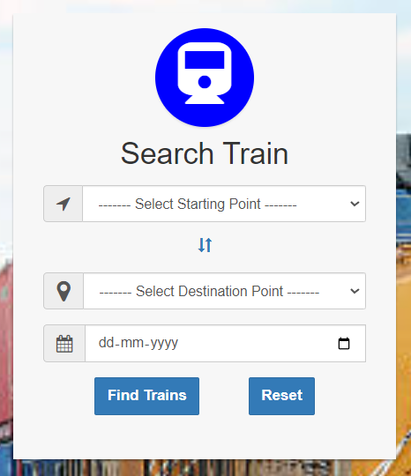
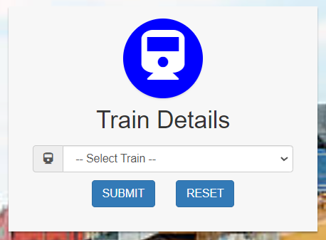
Features of the System ​​
Searching Trains
Users access search train functionality from the homepage or navigation menu.
They input criteria like origin, destination, date to find trains.
Clicking on a train displays detailed information about it.

Slide 8
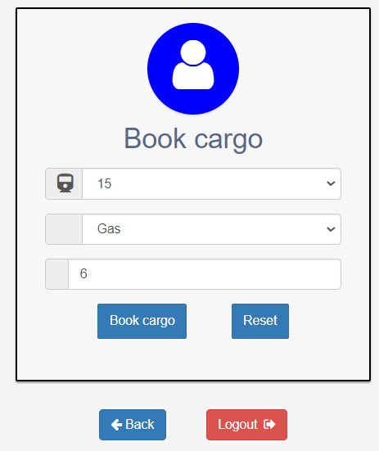
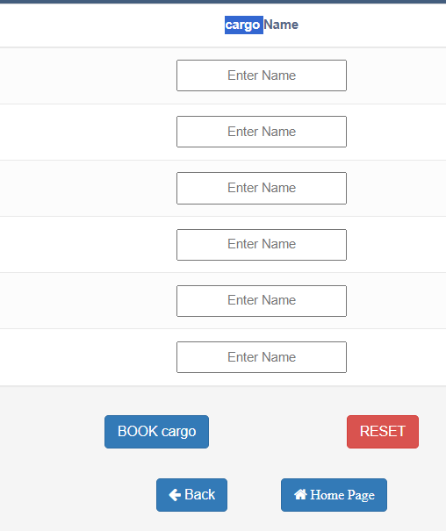
Features of the System ​​
Booking a Cargo
Users enter names of cargos into the system.
Allows users to easily identify and track specific cargos.
History of booking, current Bookings and Cancel Cargo are available for each user

Slide 9
Features of the System For Admin​
User Details
Station Details
Train Details
Train Schedule
Add Train
Booked Cargos
Cancelled Cargos
Search function
Search bar is available in every page for searching particular users/trains

Slide 10
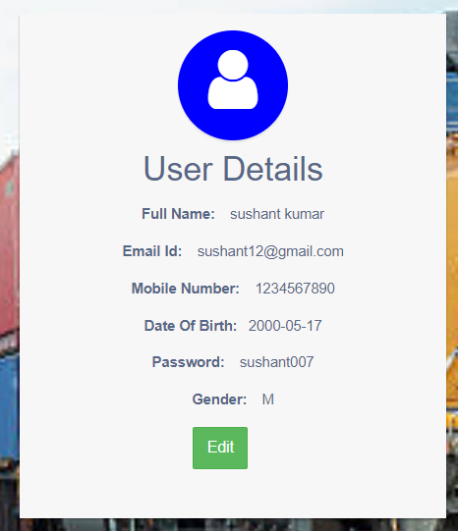
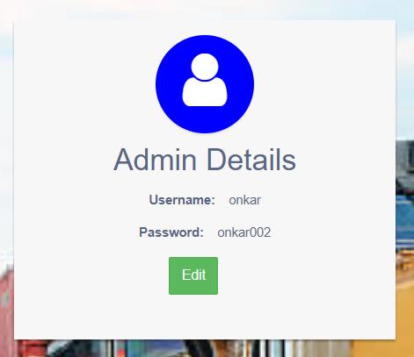
Features of the System ​
Admin and User home pages
Convenience: Provides a convenient way for administrators and users to manage their account details without requiring external assistance.
Customization: Allows users to customize their profiles and preferences according to their evolving needs and preferences.

Slide 11
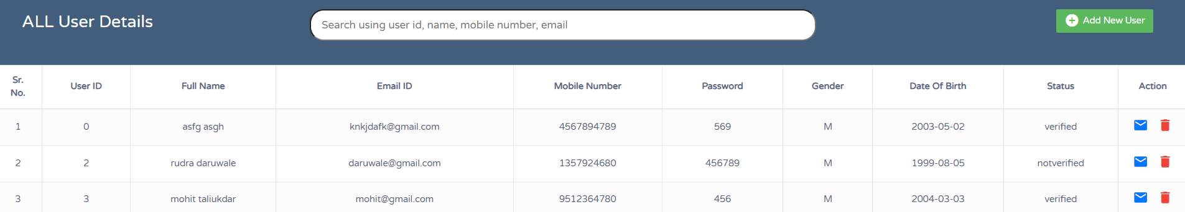
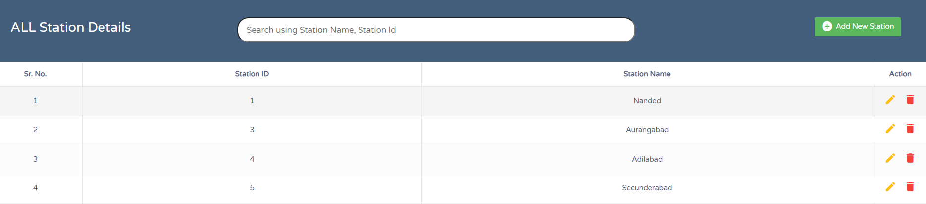
Features of the System
User details
Station Details

Slide 12
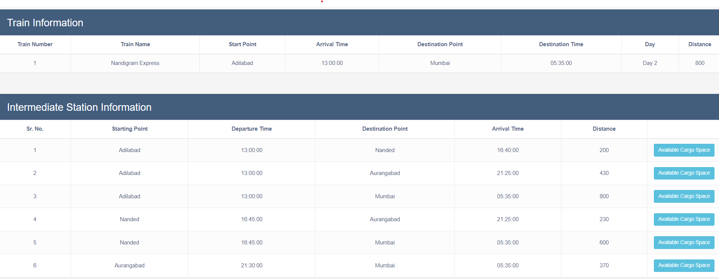
Features of the System
Intermediate station details of specific train

Slide 13
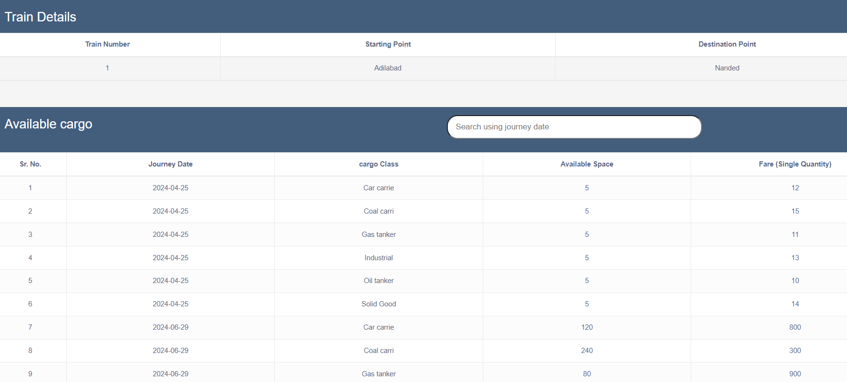
Features of the System
Details of specific train

Slide 14

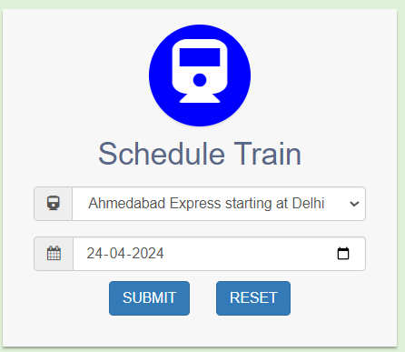
Features of the System
Schedule Train
Scheduling Algorithm:
Incorporates factors such as destination, and train capacity to determine the most efficient schedule.
Administrator Control:
Administrators can manually adjust schedules and prioritize urgent shipments as needed.
Real-Time Updates:
Users and administrators receive real-time updates on train schedules and any changes made to the schedule.

Slide 15
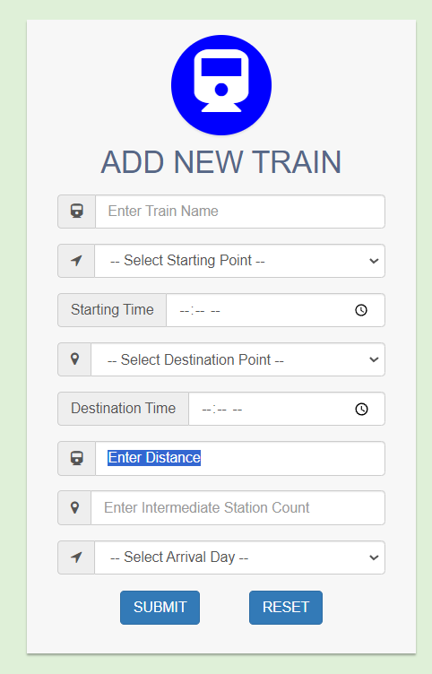
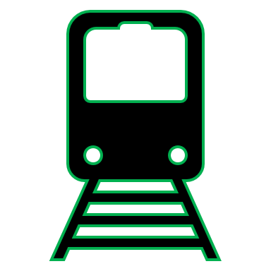
Features of the System
Adding new Train
Administrator Access:
Authorized administrators have access to the system's backend interface where they can add new trains.
Form Submission:
Administrators fill out a form specifying details such as train ID, type (e.g., Gas, Liquid, Solid), and capacity.
Validation Checks:
The system performs validation checks to ensure the entered information is accurate and complete.
Integration with Train Database:
Upon submission, the new train details are integrated into the system's train database, making it available for scheduling and tracking.

Slide 16
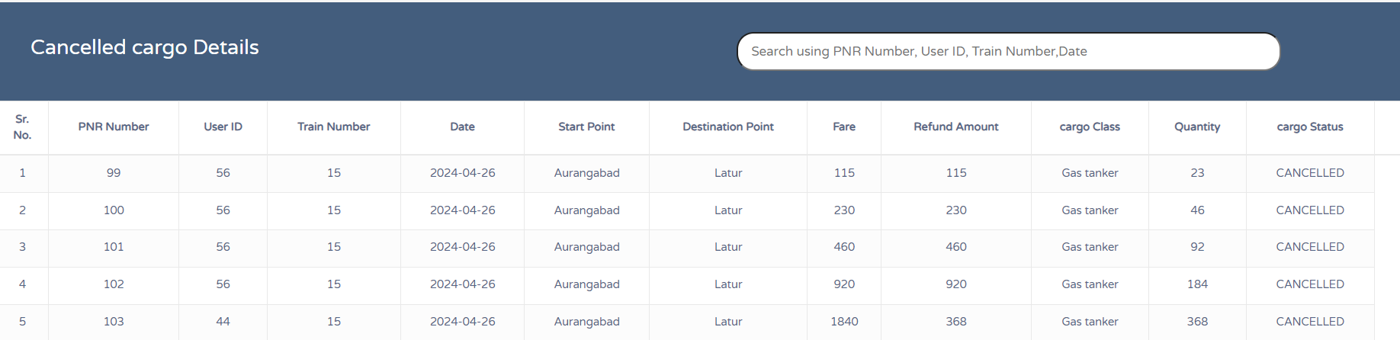
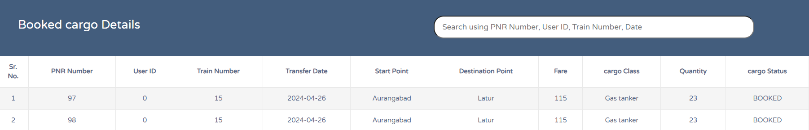
Features of the System
Refund Processing: Administrators initiate the refund process through the system, transferring the specified amount to the user's account.
Booking Details for Admin of User: It helps admin if admin wants to schedule new train analysing load

Slide 17
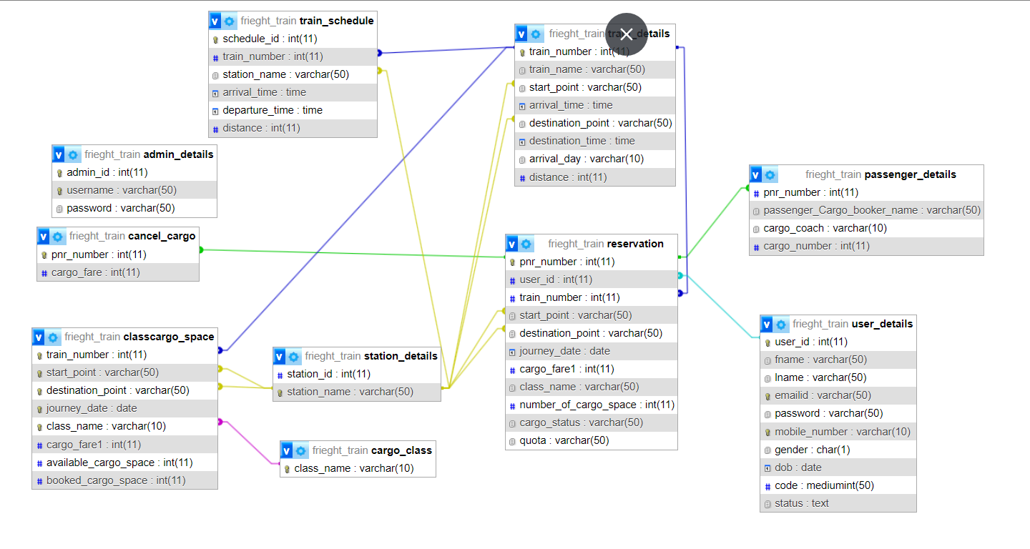
ER Diagram of Freight Train management

Slide 18

Difficulties Faced
Search Box Implementation: One of the primary difficulties encountered during the project was implementing a robust search box functionality. This involved designing and developing a search algorithm capable of efficiently retrieving relevant information from the database
Email Sending: Integrating email sending functionality using Mercury in XAMPP posed a challenge due to configuration complexities and compatibility issues. Setting up the SMTP server, configuring email templates, and ensuring reliable delivery of emails required thorough troubleshooting and testing to overcome.
Database Creation :Generating data for the database presented its own set of challenges during the project:

Slide 19
Conclusion
Developed a Freight Train Management System to streamline cargo transportation logistics.
Key features include optimized scheduling, real-time monitoring and customer satisfaction enhancement.
Implemented functionalities for booking cargo, scheduling trains, real-time tracking, and profit analytics.
Setup parameters include station and train details, while collected parameters involve cargo and scheduling data.
Provided relational tables for stations, trains, cargo, schedules, customers, bookings, and profits.
Successfully addressed challenges includes search box implementation, email sending, database generation, and cross-platform compatibility.
Concluded with a commitment to ongoing refinement, innovation, and advancement in freight logistics.

Slide 20
Thank You

